Slide 1
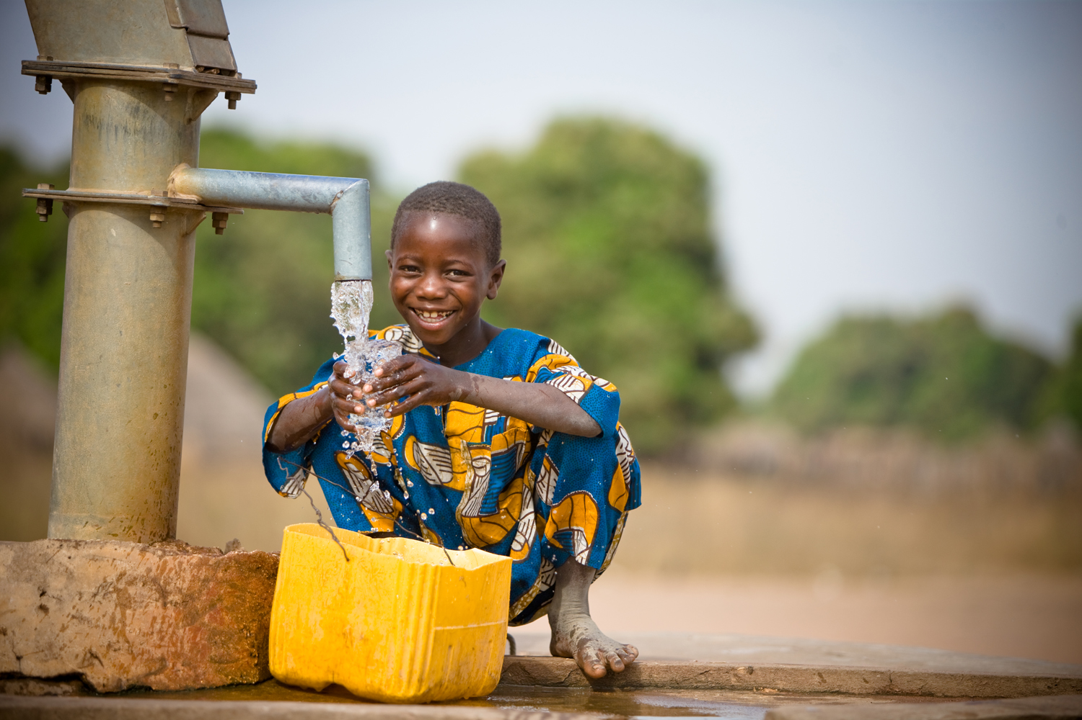

Be Water. Be Free.

Slide 2
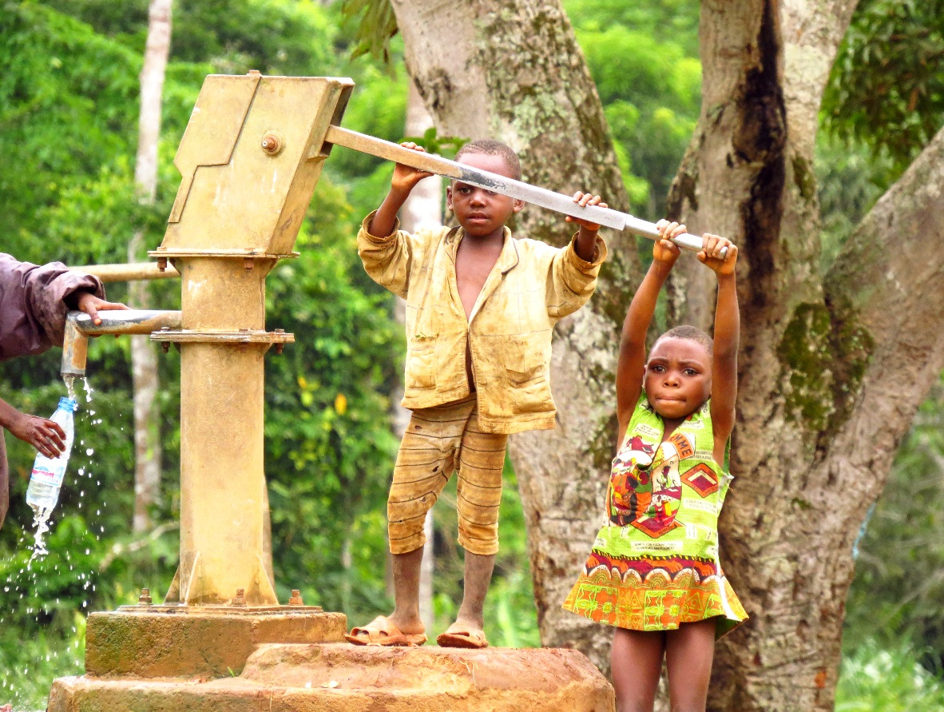
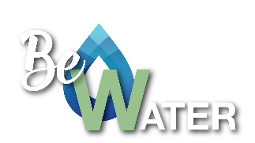
The vision
Facilitate access to clean water for as many people as possible in rural Africa.
Finance at least 1 Project per year in 1 different country in Africa.
Work with a local NGO to ensure the continuity of the Project.

Slide 3
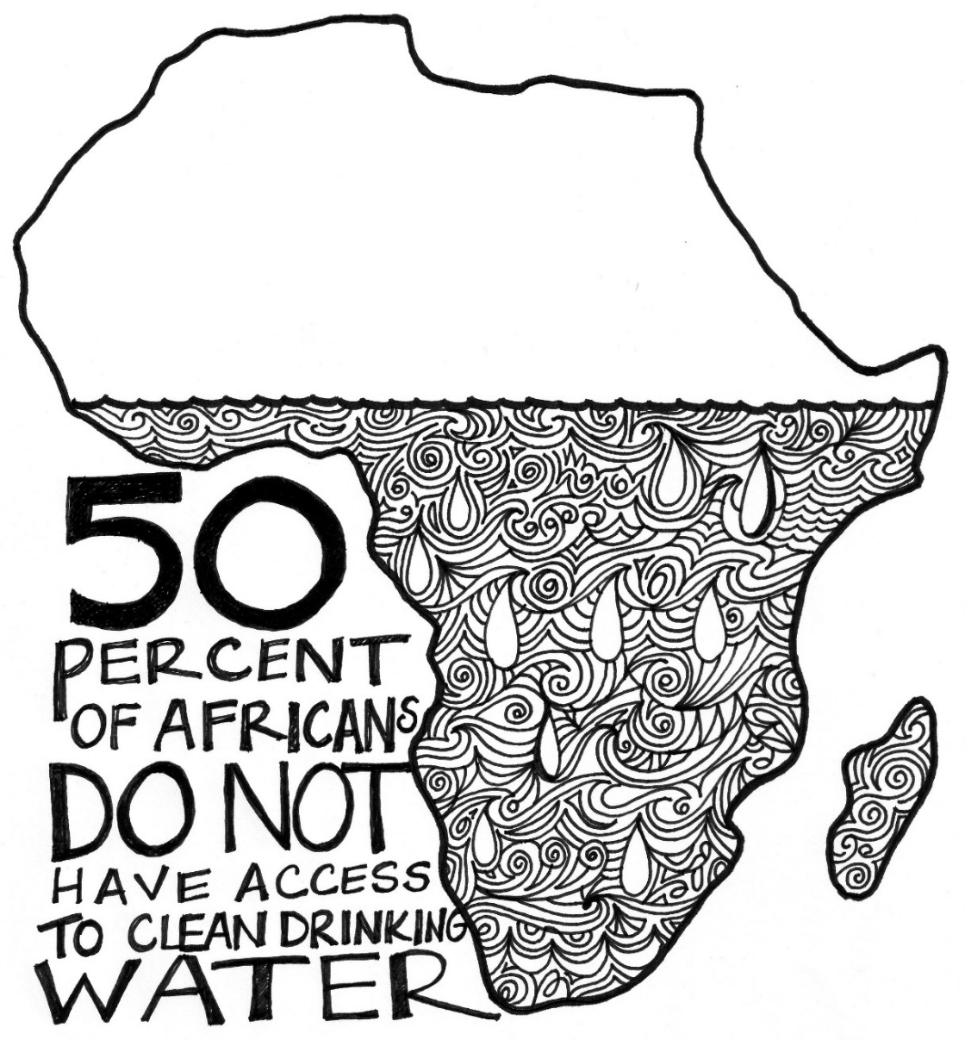
Almost 800 million people all over the world do not have access to clean water.
50% of those people live in Africa.
Contaminated water causes diseases like diarrhea and typhoid fever.
Every year +3.5 million children die from water. Diarrhea alone kills 1.8 million children a year (Barcelona's population!).
Thousands of women & girls have to walk several kms (sometimes tens) every day to get water.
+150 million children start school and are not more than 4 years old. In Sub-Saharan Africa, only 1 in 3 children goes to primary school.
The Problem

Slide 4
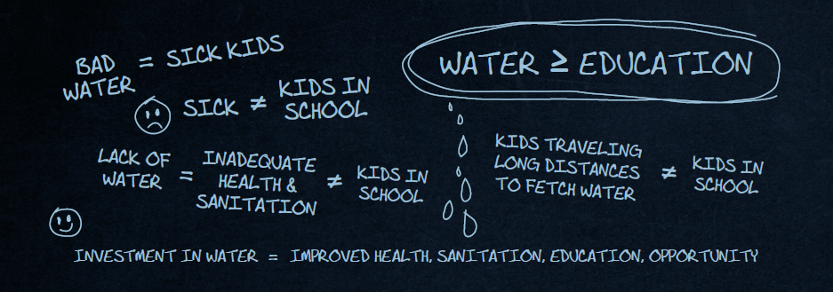
The Solution
Build projects to give clean and safe water to these communities.
Many diseases and deaths of children will be avoided.
Contaminated water = sick children = children who do NOT go to school
SOLUTION: Water well
Girls will be able to go back to school.
Lack of water = Girls walk long distances to fetch water = girls DO NOT go to school
SOLUTION: Water well

Slide 5
How are we doing it?
Step 1. Raise funds.
In 2016 = € 4,300.
In 2017 = € 5620.
In 2018 = € 3,970.
In 2019 = € 2,025.
Step 2. Find a project and a local partner to develop it with.
So far, we have done:
2017 – 2x wells in Cameroon with NGO Zerca y Lejos.
2018 – 1x water tank of 30m3 and piping system in Morocco with Acción Geoda foundation.
2018 – 1x water well with an electrosubmersible pump powered by solar panels in Tanzania with NGO Tatu Project.
Step 3. Review and evaluate the technical documentation of the project.
Step 4. Supervise the construction work on site.
Conduct water quality tests
Give training on the correct use of WATER and the pump.
Notes:
Enero 2017. En Camerún con Zerca y Lejos. Reparación de 2 pozos. Agua potable para 600 personas. Coste: 3400€.

Slide 6
We are transparent
In 2016 we raised € 4,300. In 2017 € 4,620.
100% of the money raised by Be Water goes to projects.
2017
Activity | Date | Amount Raised
Donation | 2017 | 630 €
Squash Tournament | feb-17 | 300 €
II Be Water Music Concert | may-17 | 1.890 €
Bike race | may-17 | 385 €
III Pádel Tournament | may-17 | 350 €
Silva de Sirenas Concert | jul-17 | 485 €
IV Pádel Tournament | oct-17 | 235 €
Xmass Lottery | dic-17 | 345 €
Total |  | 4.620 €

Slide 7
In 2018 we raised € 3,970.
2018
Actividad | Fecha | Cantidad Recaudada
Donation | 2018 | 800 €
Donation | 2018 | 1.150 €
Marathon race (objetivo Be Water) | may-18 | 165 €
V Pádel Tournament | jun-18 | 300 €
KPMG Pádel Tournament | jul-18 | 110 €
Silva de Sirenas Concert | jul-18 | 350 €
Rural Market in Asturias | ago-18 | 745 €
VI Pádel Tournament | sep-18 | 235 €
Xmass Market | dic-18 | 115 €
Total |  | 3.970 €

Slide 8
In 2019 we raised € 2,025.
2018
Actividad | Fecha | Cantidad Recaudada
Donation | 2019 | 500 €
III Be Water Music Concert | may-19 | 950 €
VII Pádel Tournament | sep-19 | 350 €
Xmass Market | dic-19 | 225 €
Total |  | 2.025 €

Slide 9
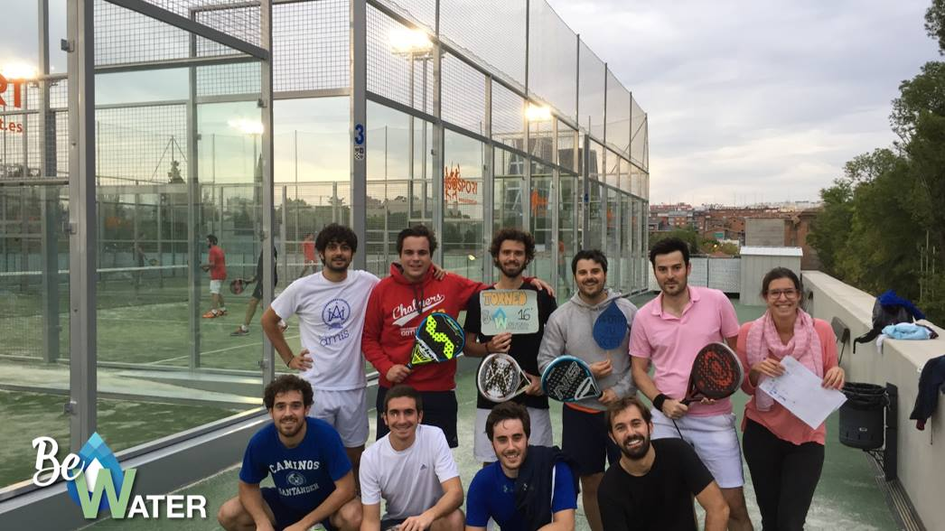
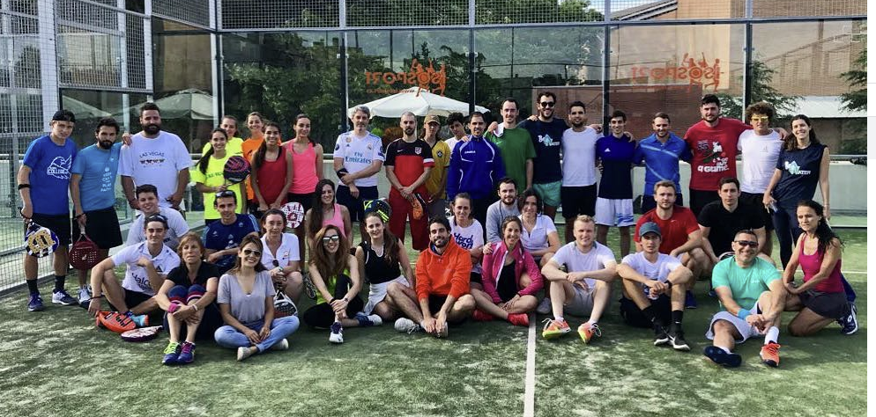
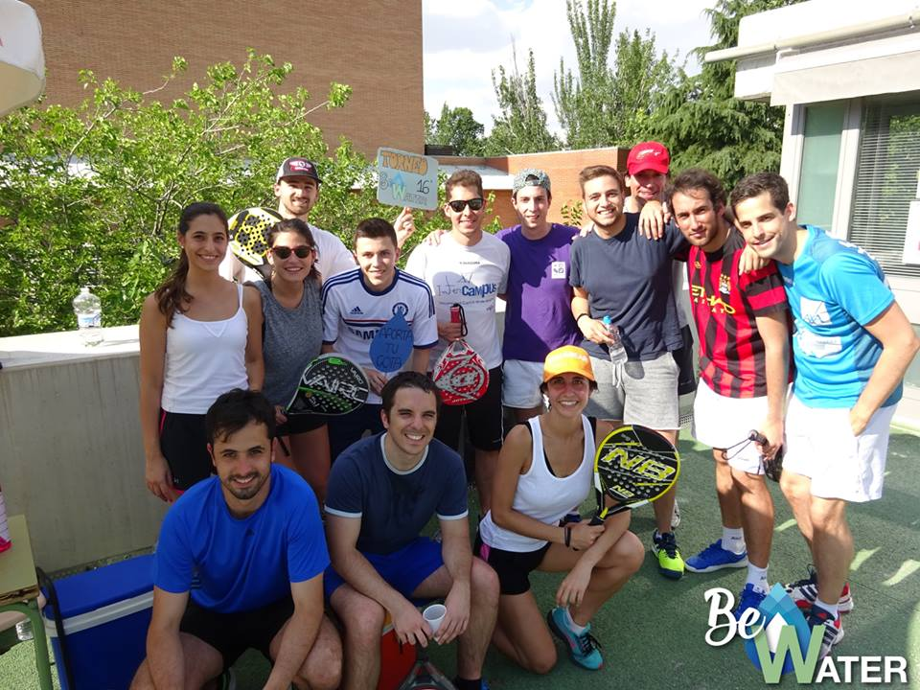
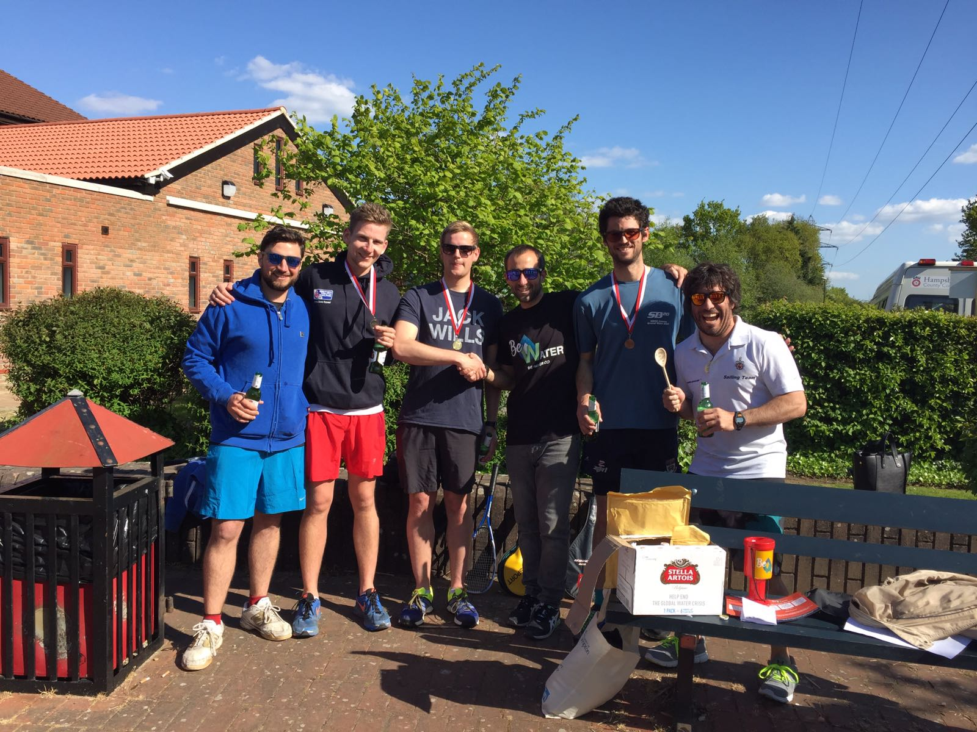
Pádel & Squash Tournaments
Notes:
Proximo Torneo el Domingo 28 de mayo en el colegio nta señora del Recuerdo de 5 a 9pm

Slide 10
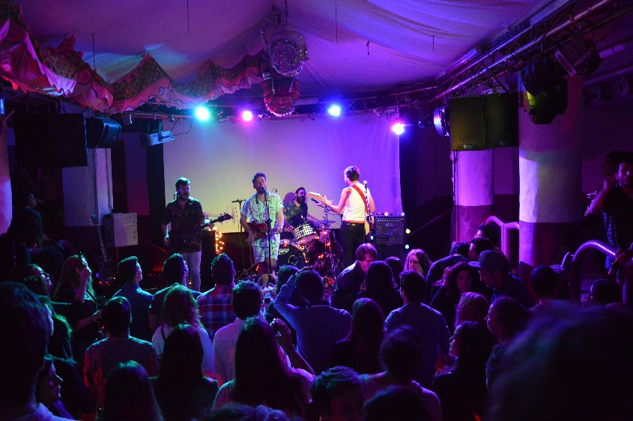
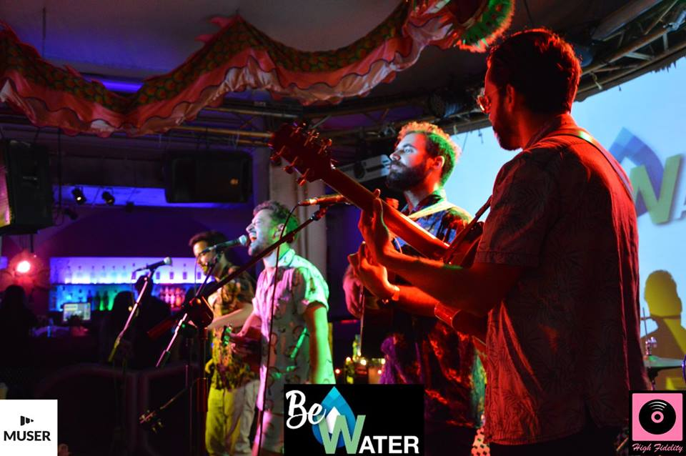
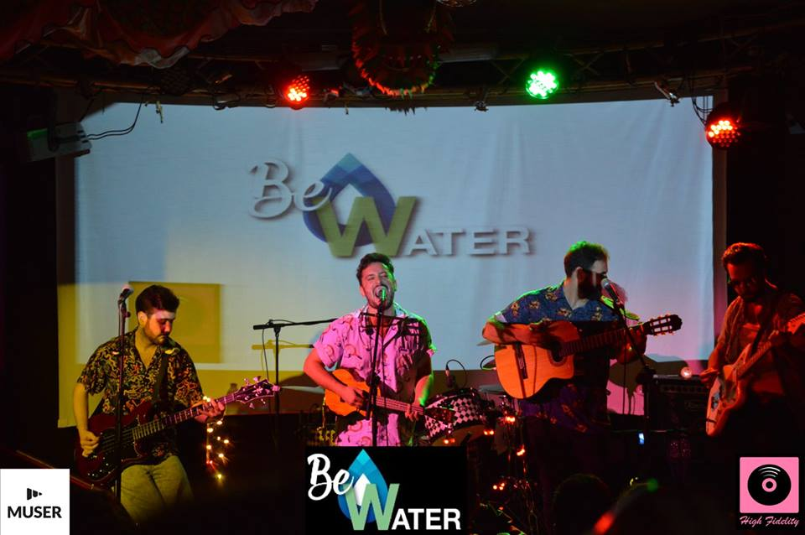
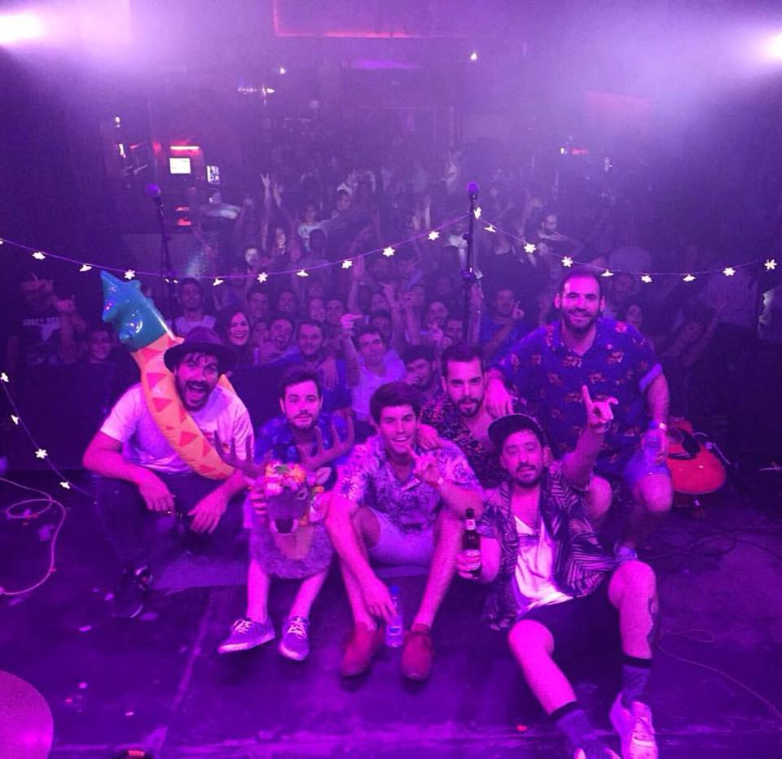
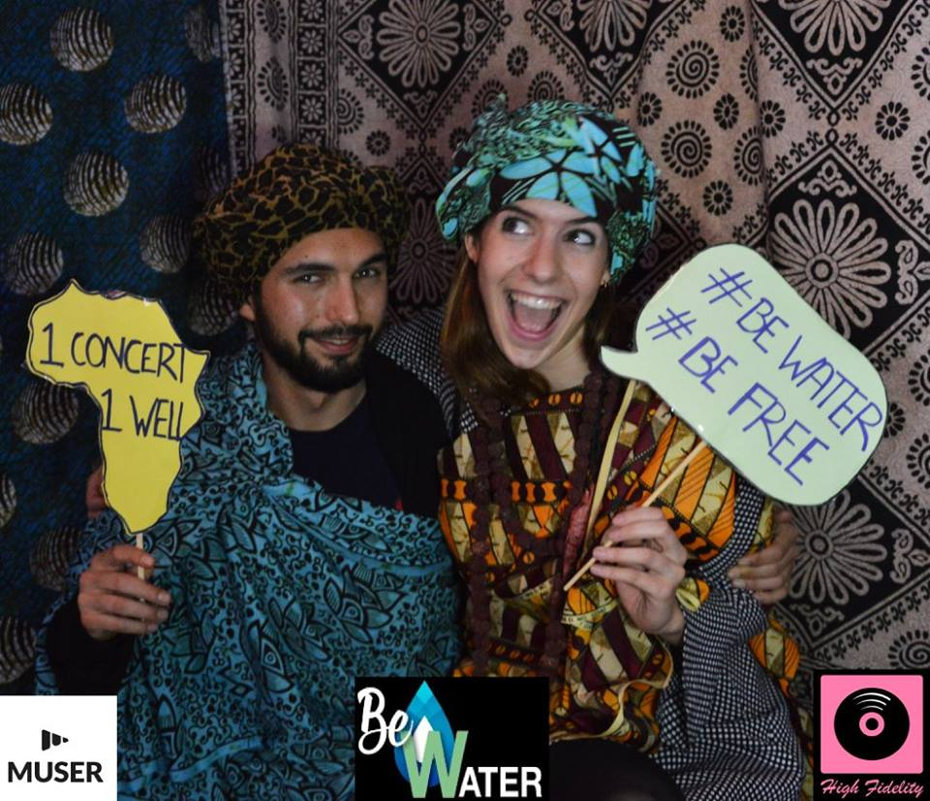
Fundraise Concerts
Notes:
Proximo concierto el dia 10 de Junio. Capitán Cobarde, Astola y Mamita Papaya.

Slide 11
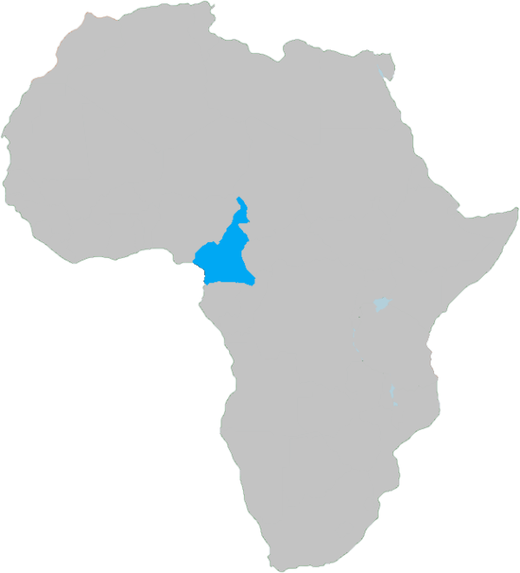
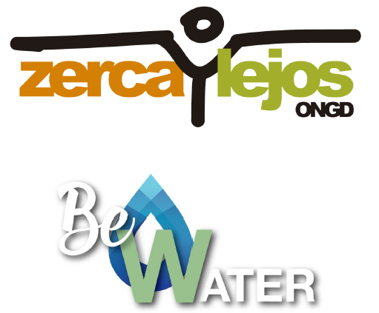
Our Achievements in 2017 - CAMEROON

Slide 12
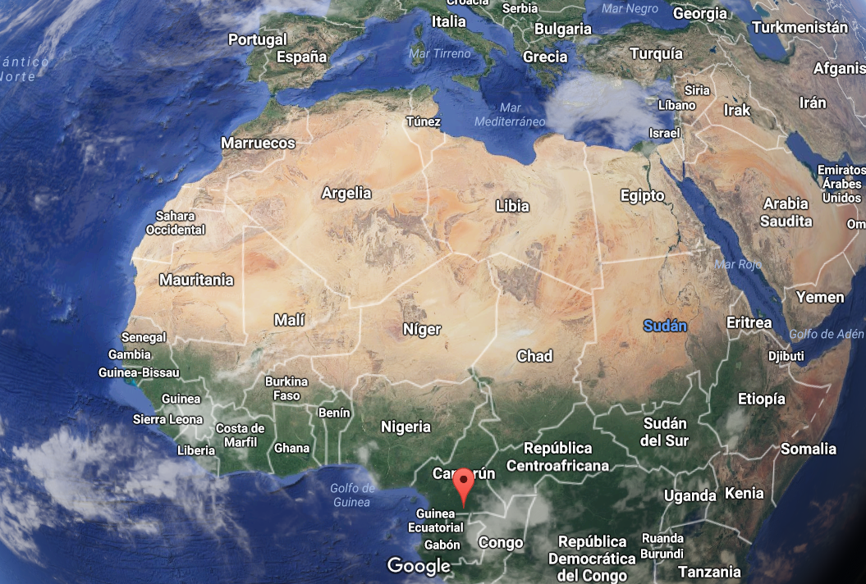


2017 Project - Cameroon
Partner: Zerca y Lejos ONGD
Country: Cameroon
Date: January 2017
Project: Repair 2 water wells (1 pygmy indigenous town + 1 school)
Project cost: € 3,400
Be water contribution: € 1,700 (50%)
Access to water: 600 people.
6600 km

Slide 13
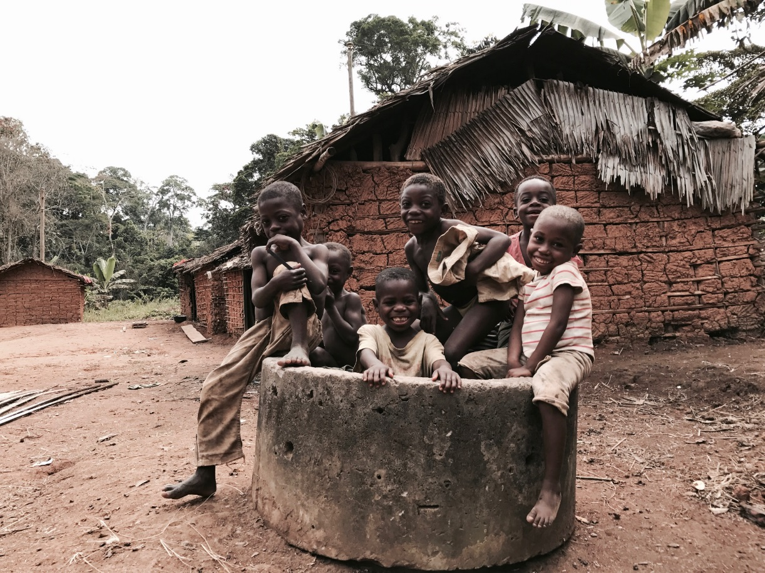
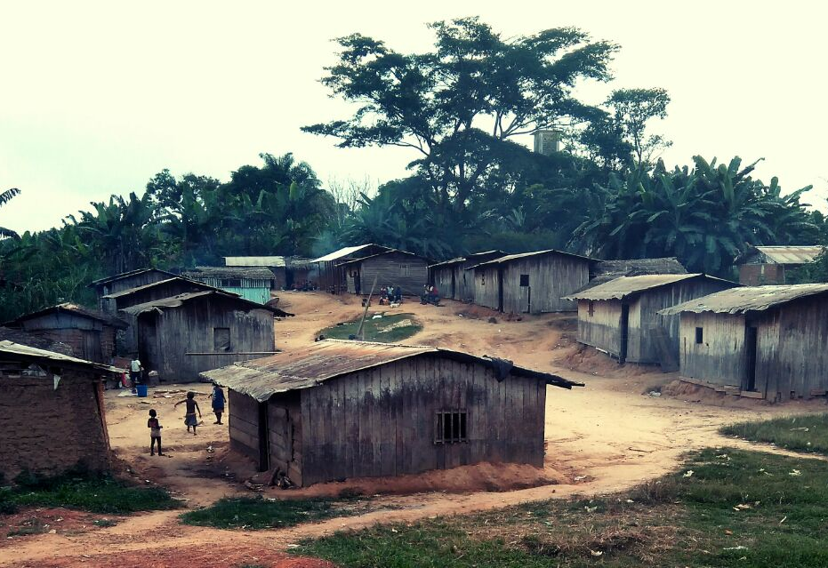
2017 Project - Cameroon
1st well was made in a pygmy indigenous town.
Population: 60 people

Slide 14
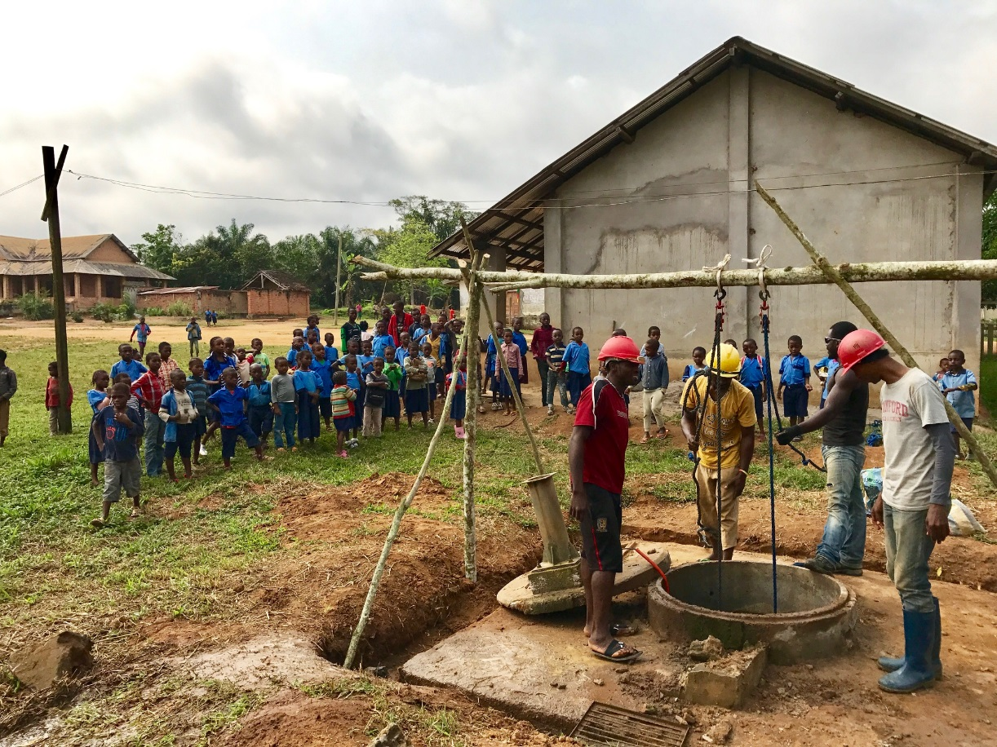
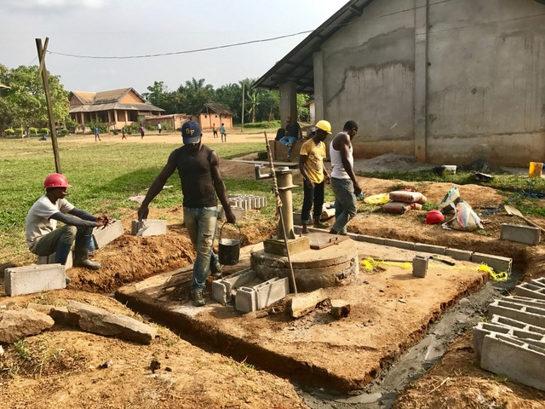
2017 Project - Cameroon
2nd well was made at the Djoum College
Population: 400 students + 2 nearby pygmy towns of 60 people

Slide 15
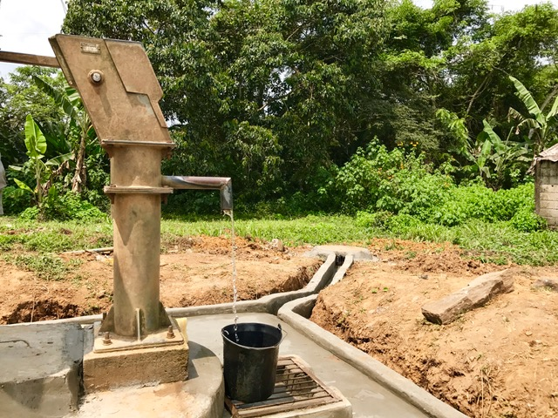
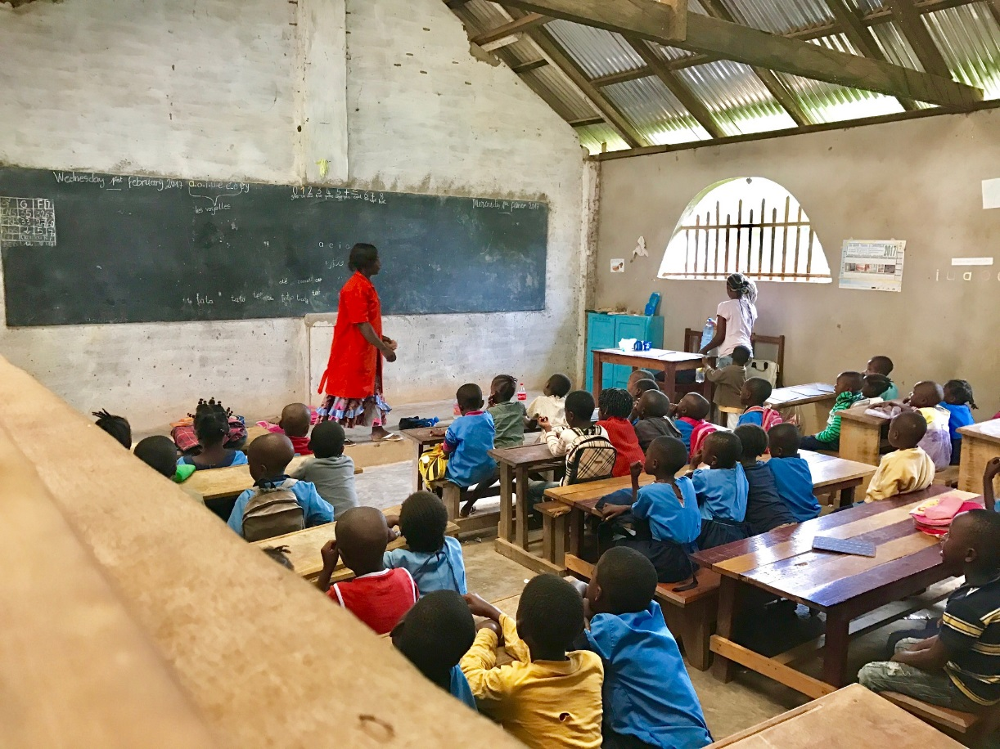
2017 Project - Cameroon
2nd well was made at the Djoum College
Population: 400 students + 2 nearby pygmy towns of 60 people

Slide 16
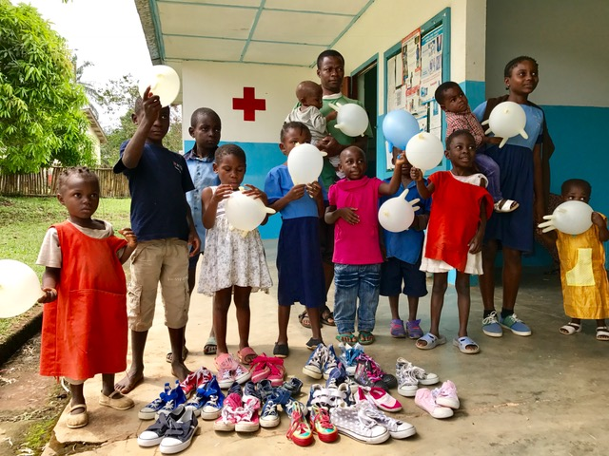
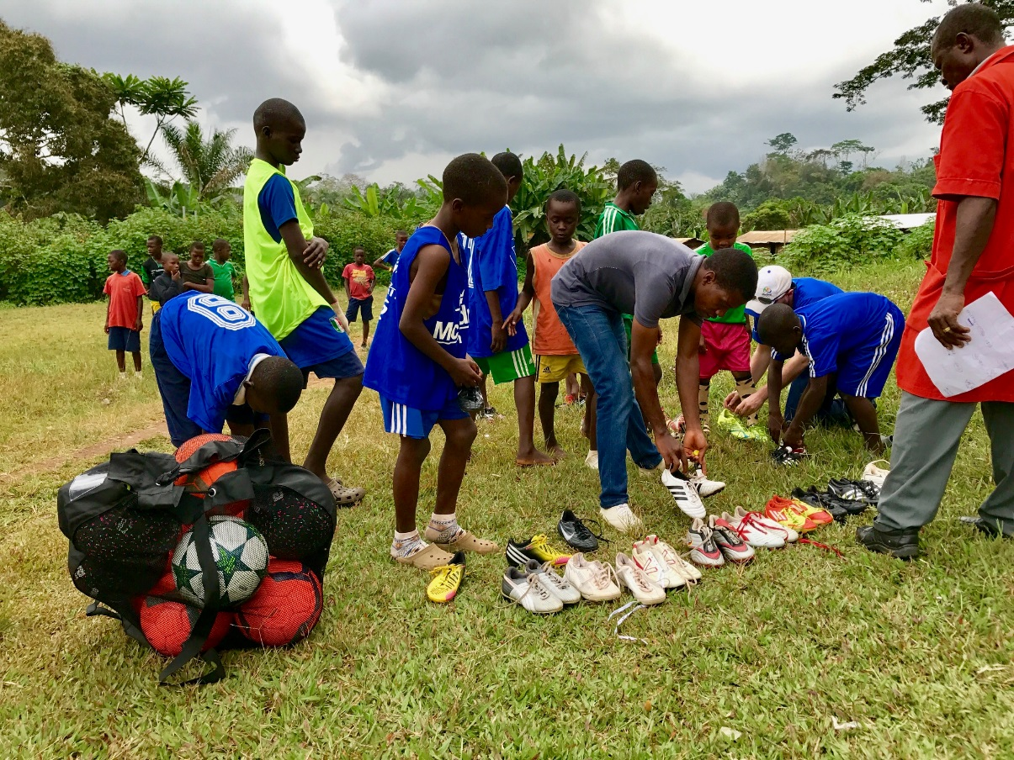
2017 Project - Cameroon
20 pairs of children's shoes were purchased for the Abing foster home.
10 balls and 20 pairs of football boots were purchased for the Djoum school.

Slide 17
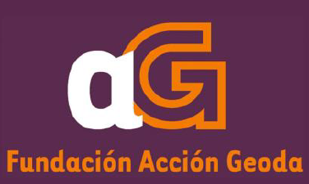
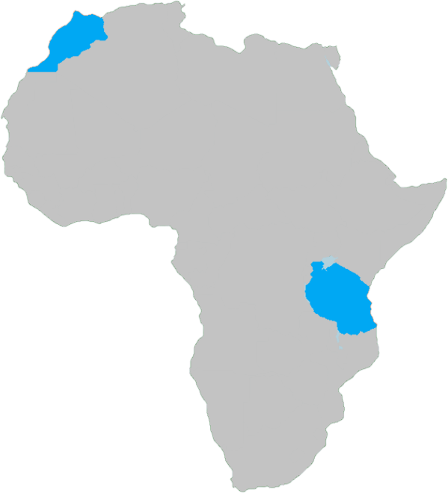

Our Achievements in 2018 – MOROCCO & TANZANIA

Slide 18
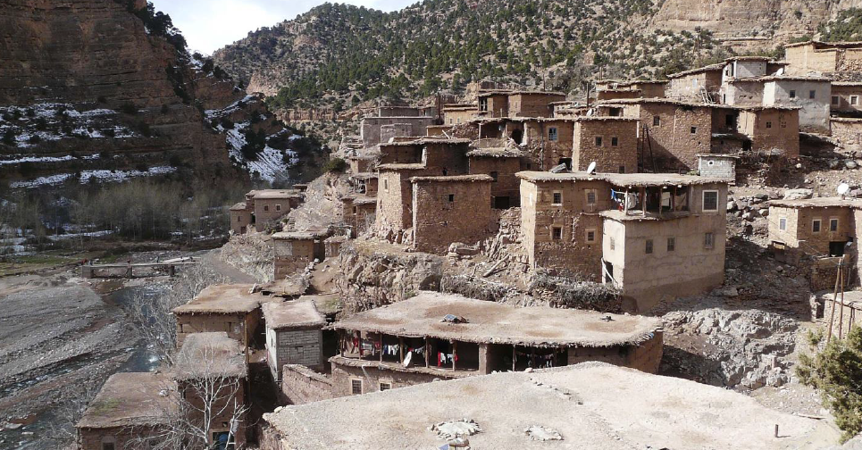
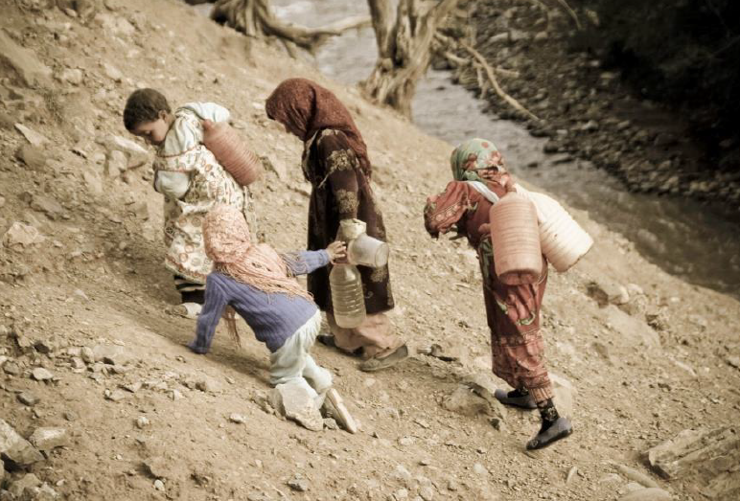

2018 Project - Morocco
Partner: Geoda Action
Country: Morocco
Town: Imin Tizhgi
Date: July 2018
Project: Construction of a 30m3 water tank.
Project cost: € 12,260
Be water contribution: € 4,000 (32.6%)
Access to water: 700 people.

Slide 19
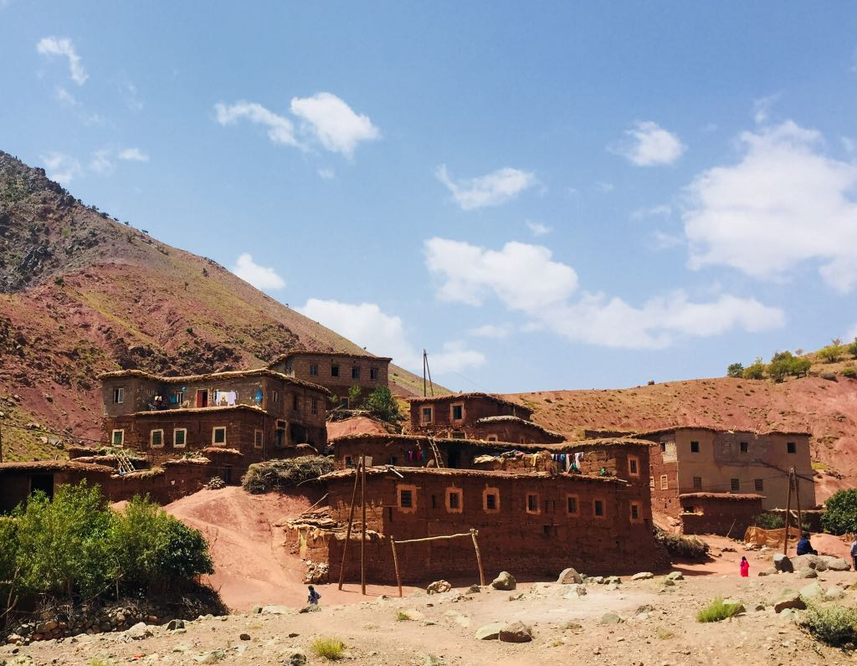
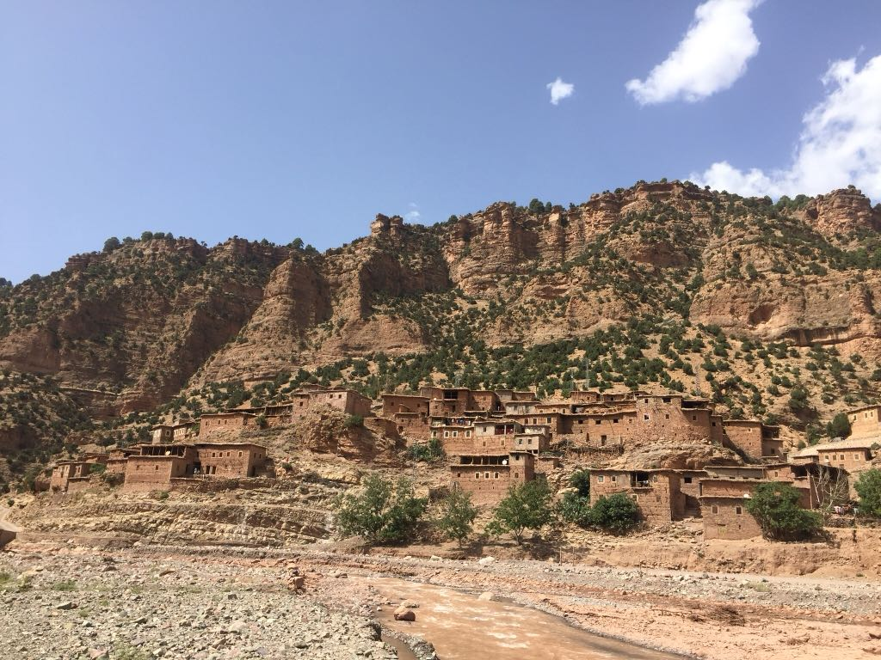
2018 Project - Morocco

Slide 20
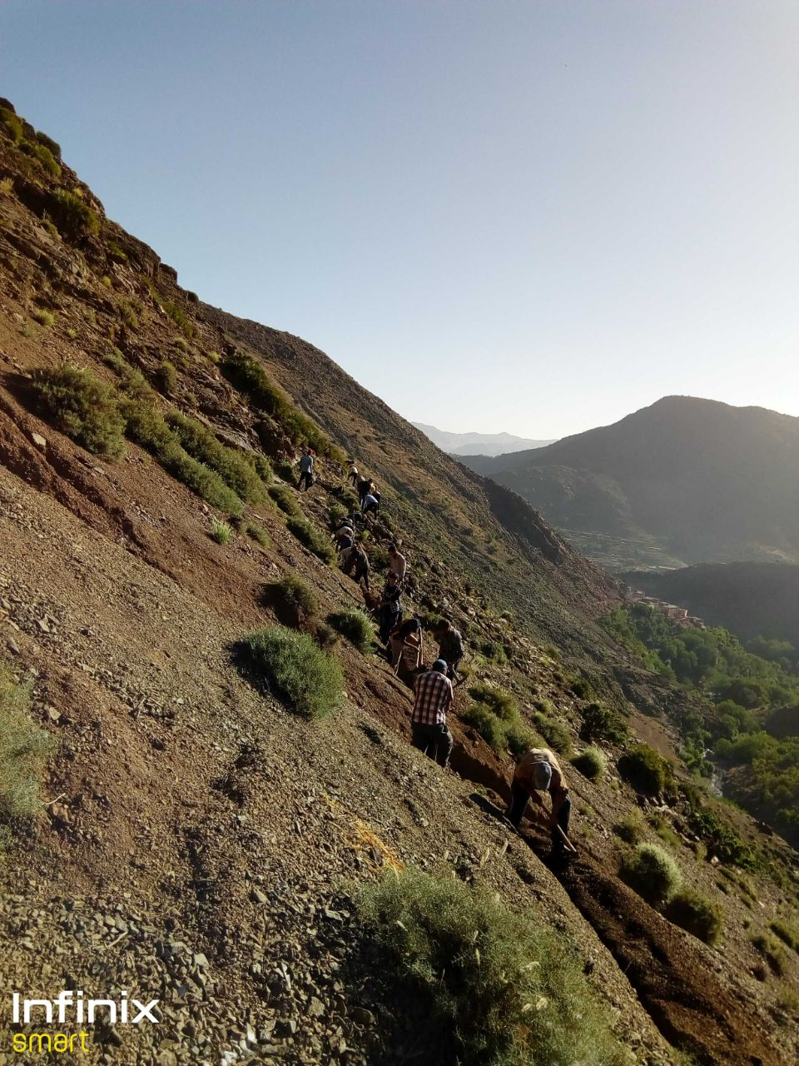
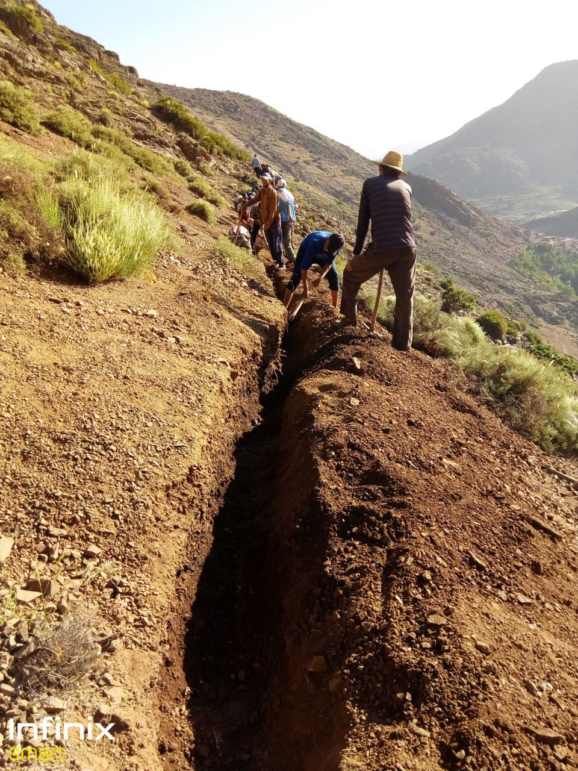
2018 Project - Morocco

Slide 21
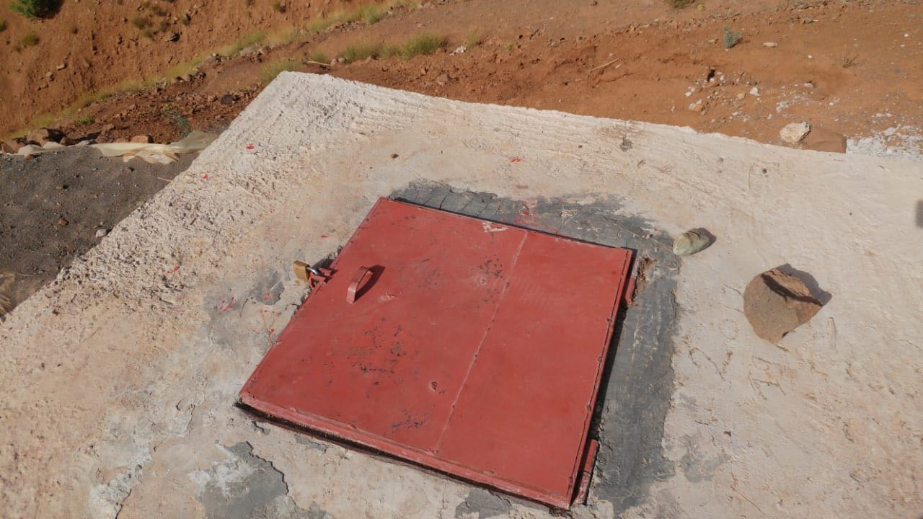
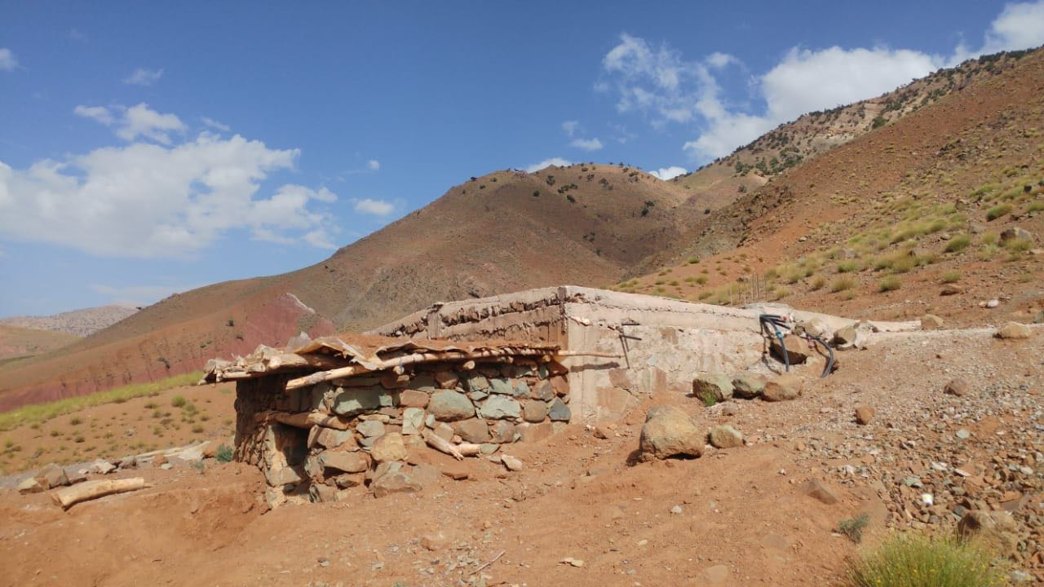
2018 Project - Morocco

Slide 22
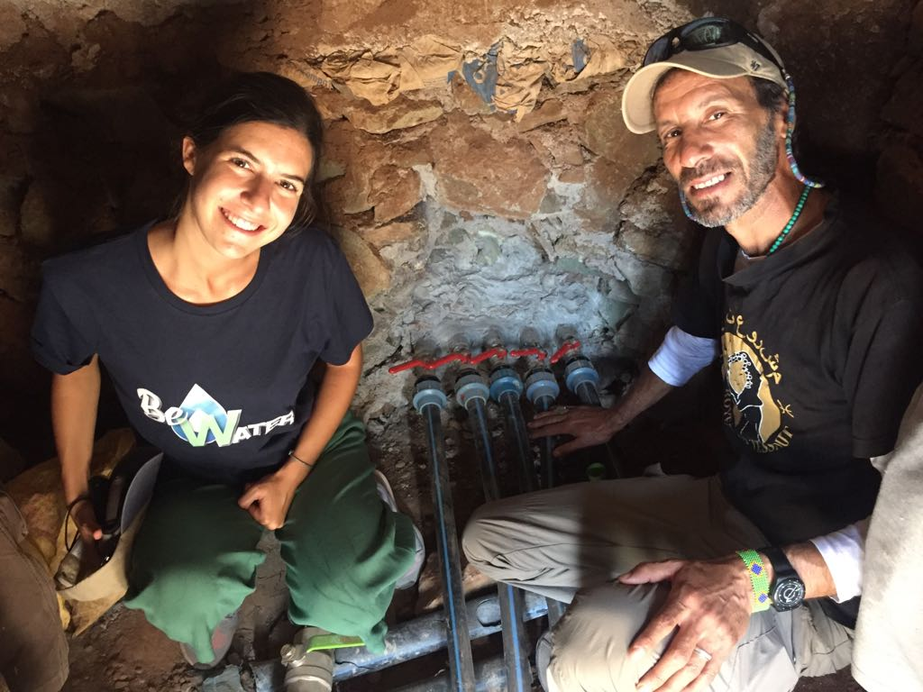
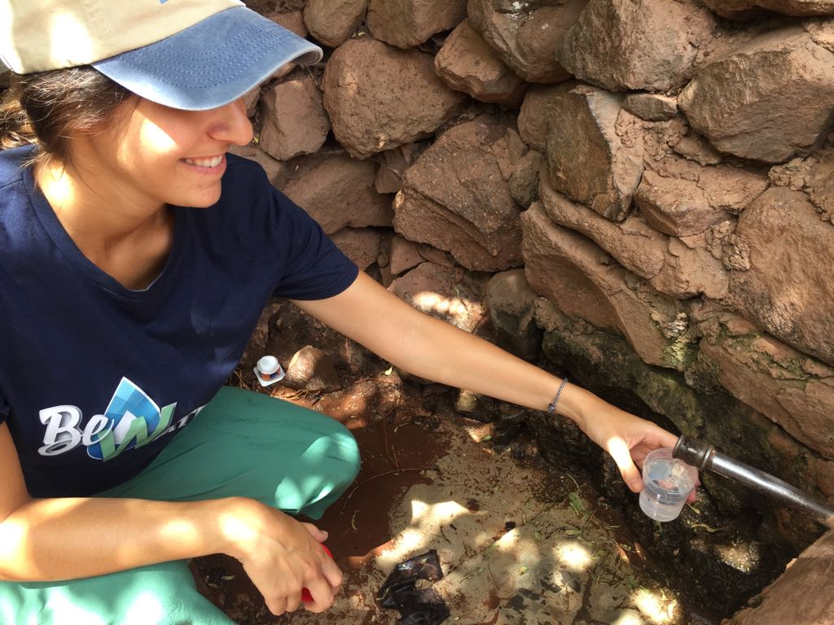
2018 Project - Morocco

Slide 23
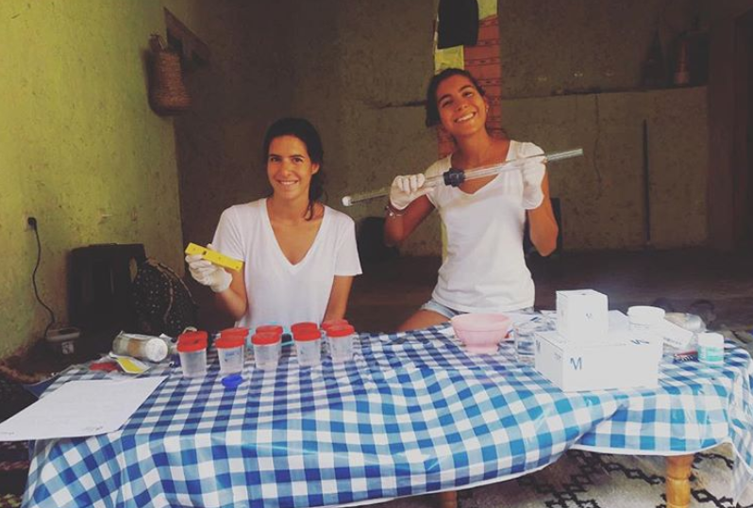
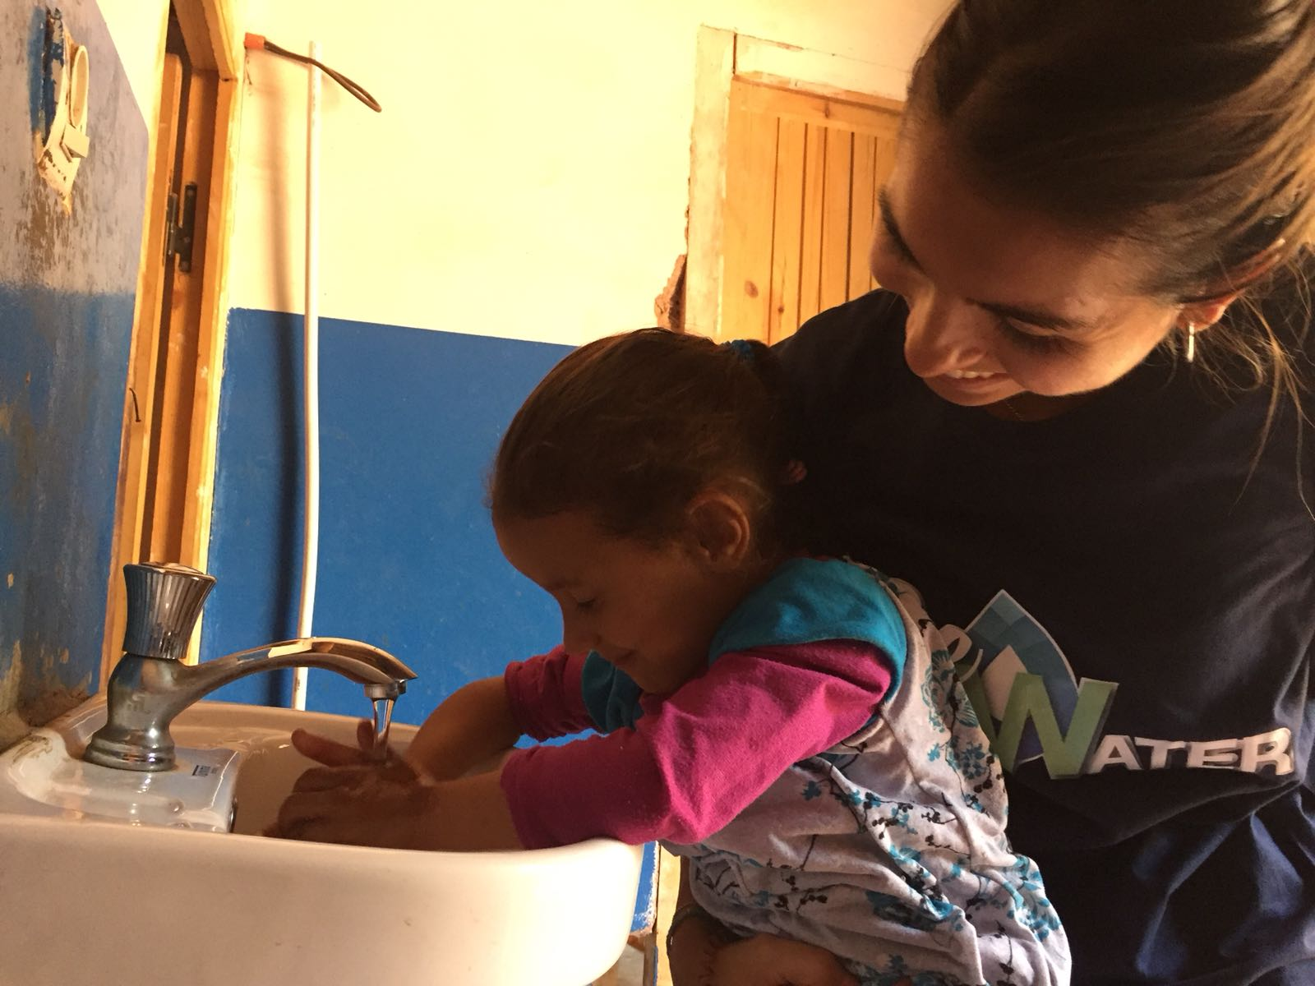
2018 Project - Morocco

Slide 24
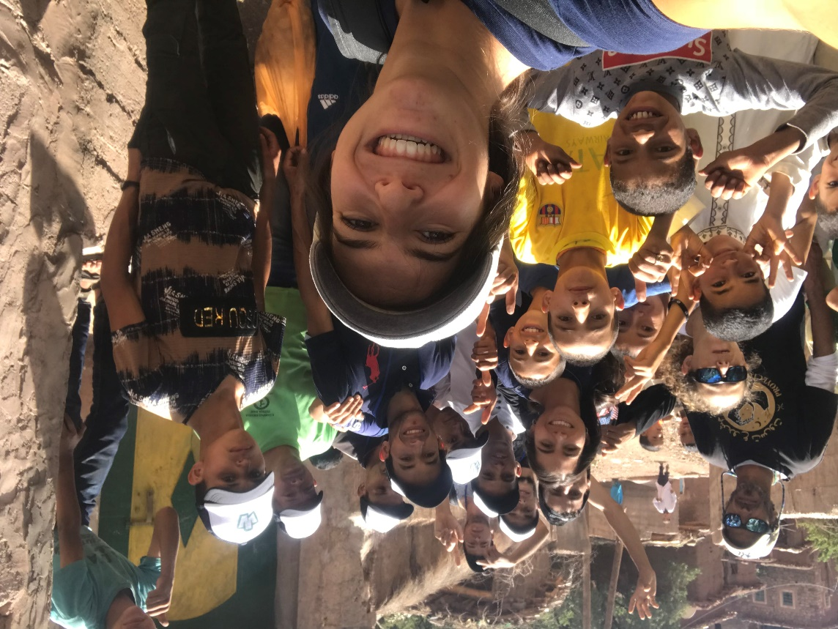
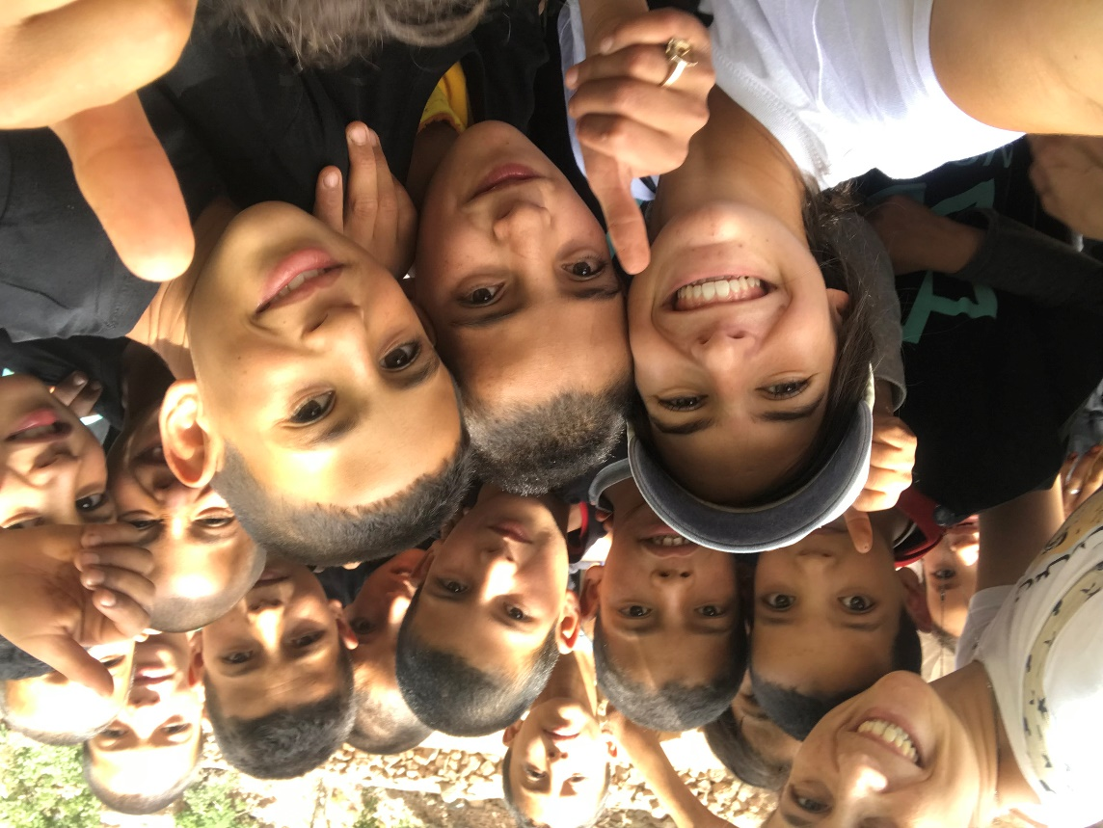
2018 Project - Morocco

Slide 25
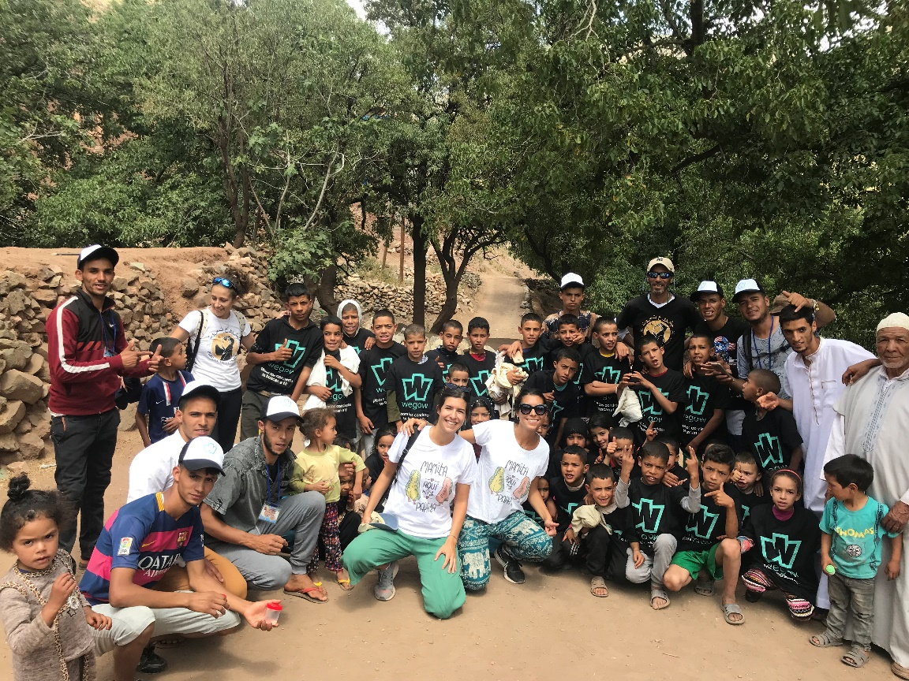
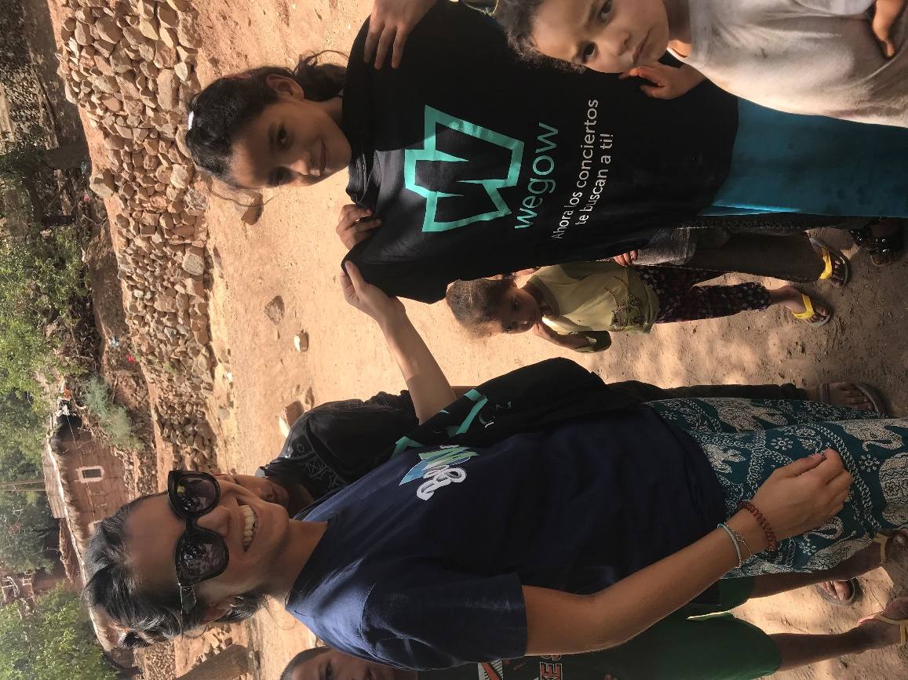
2018 Project - Morocco

Slide 26
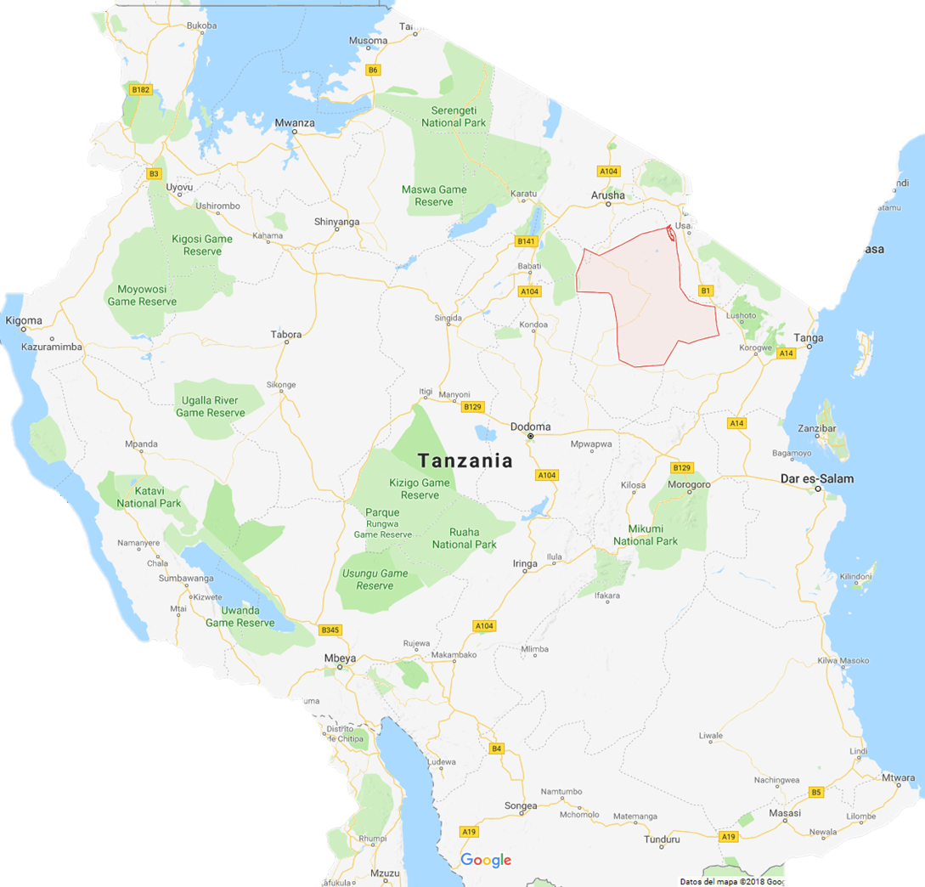
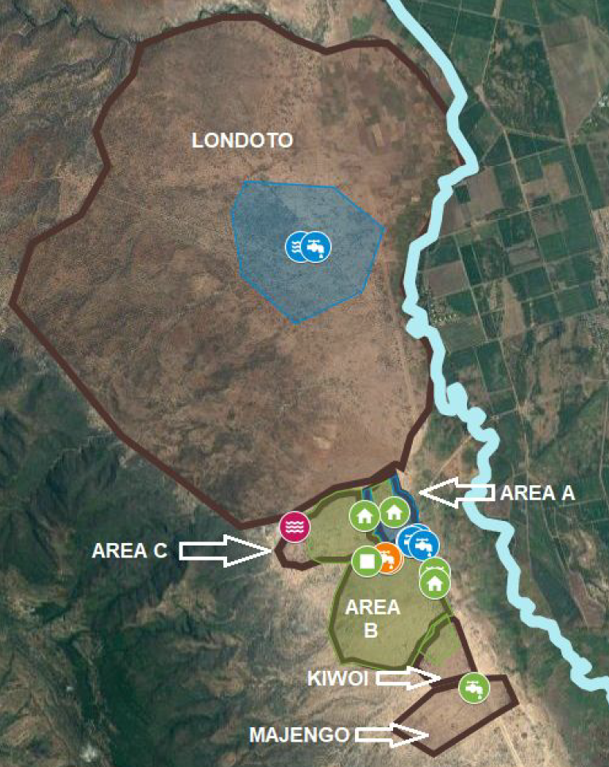
2018 Project - Tanzania
Partner: Tatu Project
Country: Tanzania
Town: Kiwoi and Majengo
Date: October 2018
Project: Construction of a water well with an electro-submersible pump and solar panels.
Project cost: € 25600
Be water contribution: € 6,000 (24%)
Access to water: 1130 people.

Slide 27
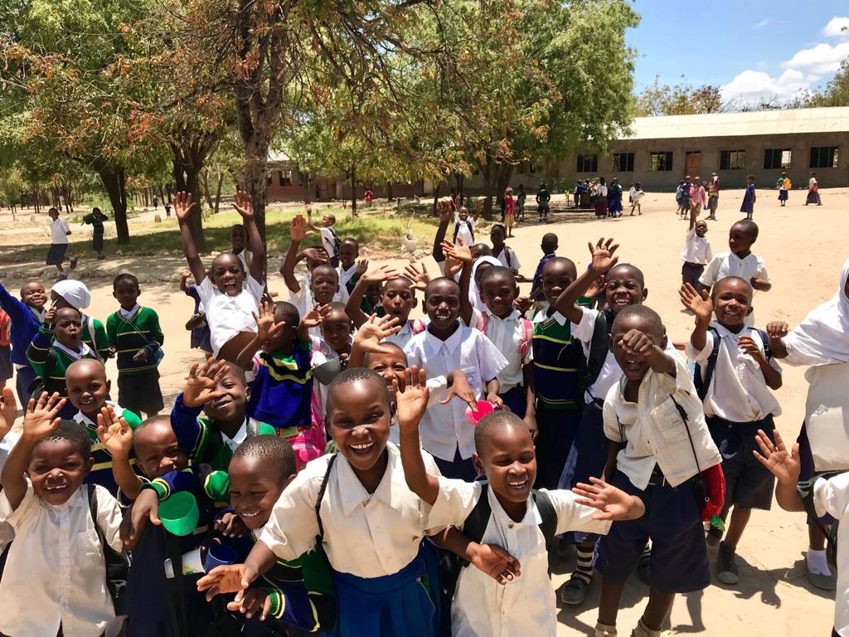
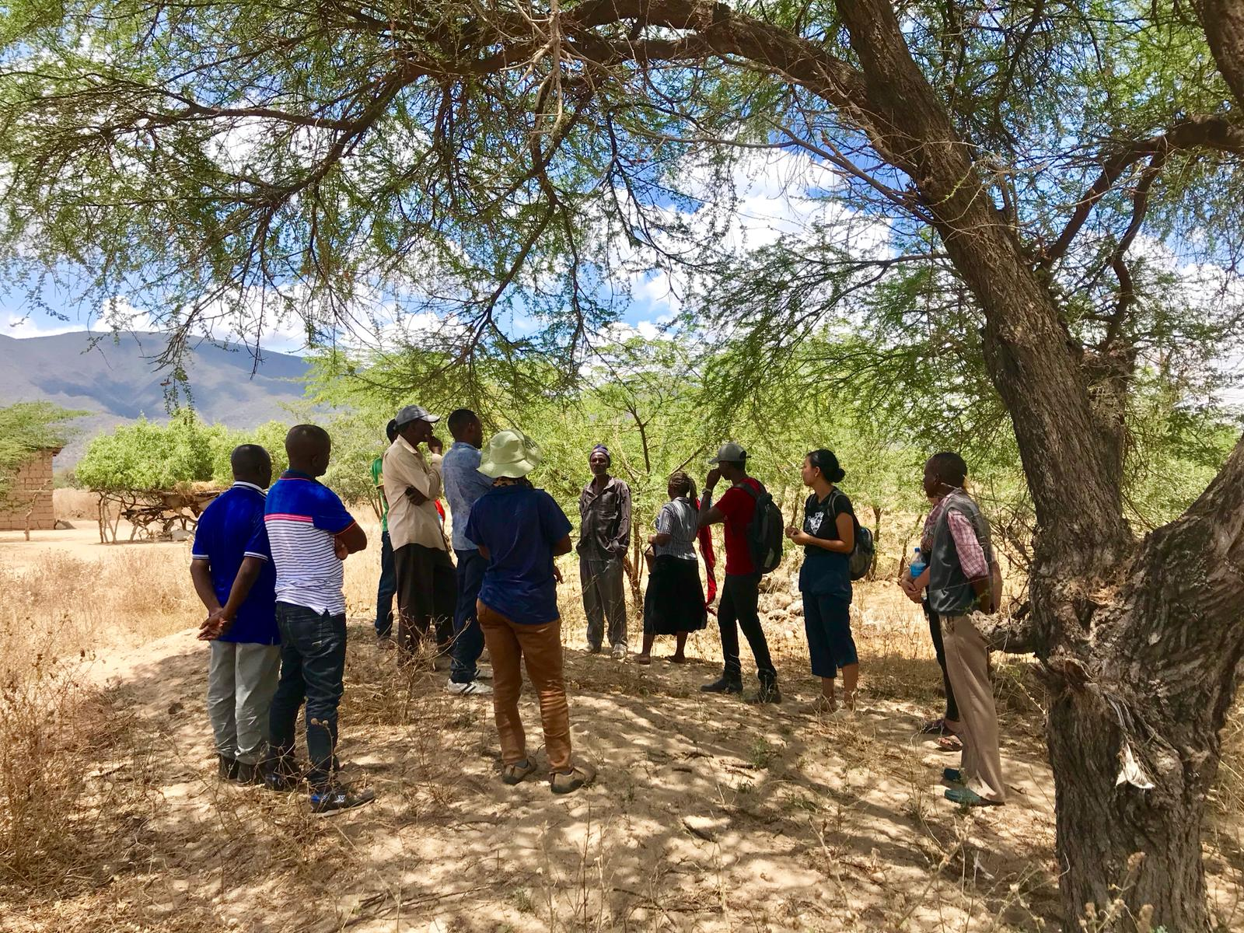

2018 Project - Tanzania

Slide 28
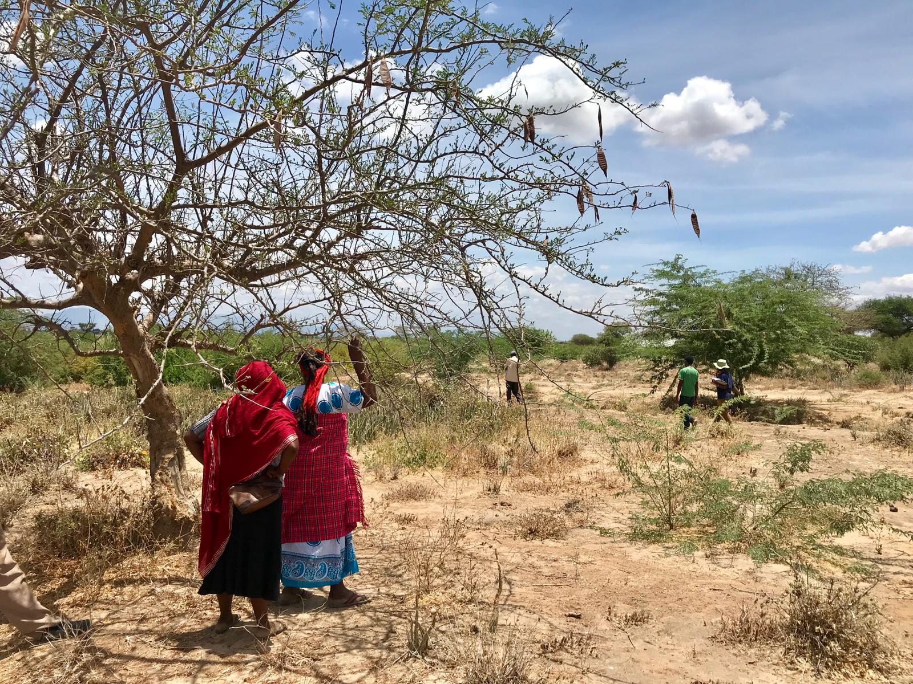
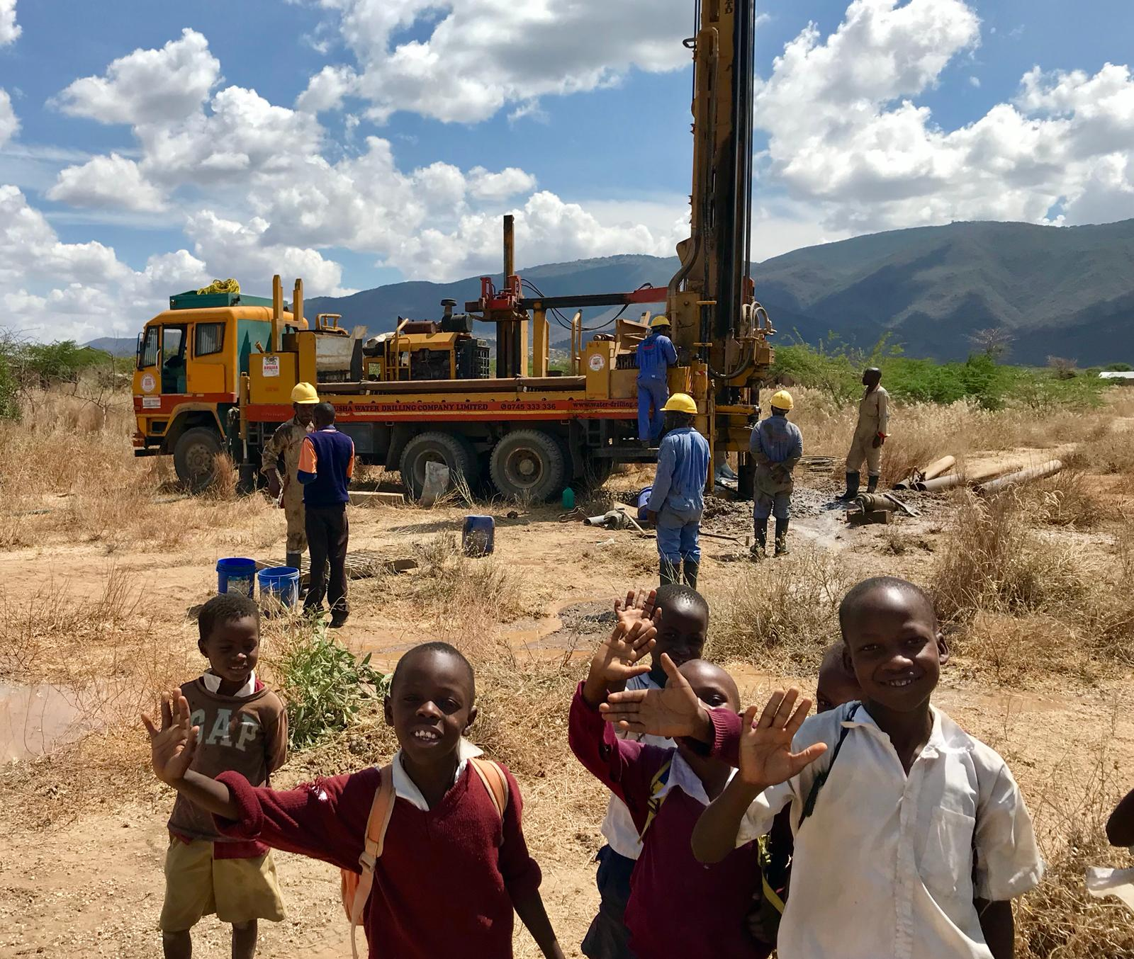
2018 Project - Tanzania

Slide 29
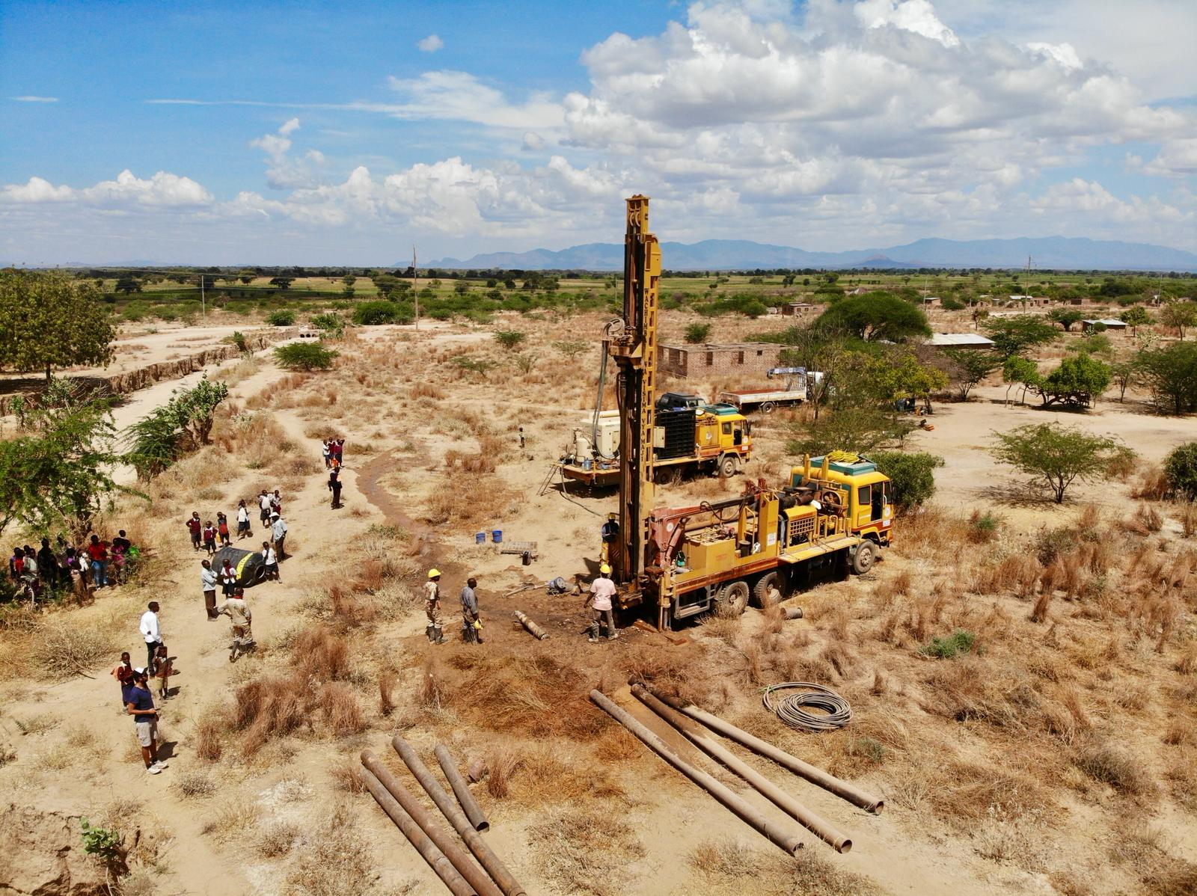

2018 Project - Tanzania

Slide 30


2018 Project - Tanzania

Slide 31


2018 Project - Tanzania

Slide 32


2018 Project - Tanzania

Slide 33

Achievements Accomplished
Gente con Acceso al Agua
2430
Proyectos Financiados
3
Países Ayudados
3

Slide 34

Be Water. Be Free.

